Slide 1

Green world bank
PROJECT NAME: BANK MANAGEMENT

Slide 2
Taught by: 1.dr bou channa (cours)
2.dr chan sophal (tp)

Slide 3

Green world bank
Team Member:
Chou Vandy(leader) id:e20200664
Chhon Chaina id:e20200934
Long Channleap id:e20200386
Kheang Tongheang id:e20200472
Hok Ratanak id:e20201106

Slide 4
1.Introduction
A bank is a financial institution which accepts deposits, pays interest on pre-defined rates, clears checks, makes loans, and often acts as an intermediary in financial transactions. It also provides other financial services to its customers. Bank management governs various concerns associated with bank in order to maximize profits. The concerns broadly include liquidity management, asset management, liability management and capital management. We will discuss these areas in later chapters.

Slide 5
BANK MANAGENMENT
ACCOUNT
LOANED
DESPOSITION
TRANSFER
SERVICES

Slide 6
Account
Customer
ATM-Transaction
Current Account
Saving Account

Slide 7
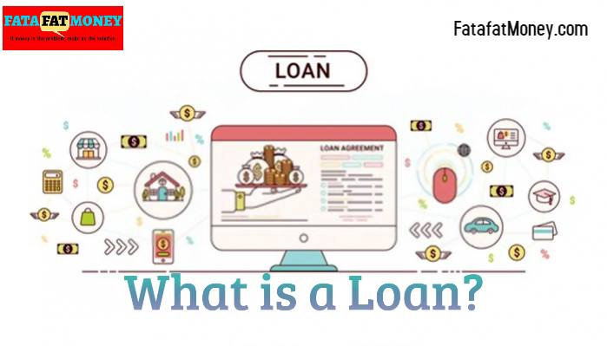
A thing that is borrowed, especially a sum of money that is expected to be paid back with interest.

Slide 8
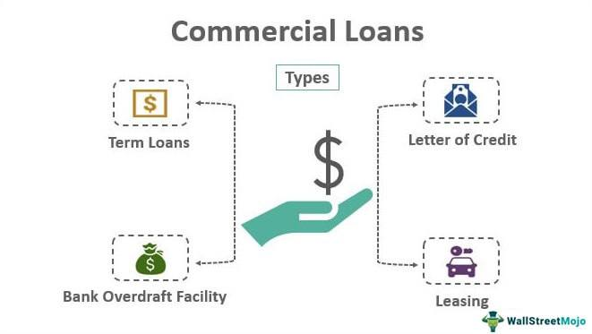
Revolving loans and long-term loans
Loans can also be described as revolving or fixed term. Repayment refers to a loan that can be repaid and repaid, while a term loan refers to a loan that is repaid in equal monthly installments over a fixed period. Credit card is an unsecured and revolving type of credit. Home loans, on the other hand, are credit infrastructure (HELOC) and have revolving credit. Car loans, on the other hand, are secured and can be term-specific loans, and signature loans are unsecured and term-limited.

Slide 9
+ General Deposit
Customer amount
+ limited Delivery
- Company terms
Customer amount
Savings period
Interest provided by the company

Slide 10
+ Transfer
Local transfer
Overseas transfer

Slide 11
Services
Water Bill
Electricity of Cambodia
School Bills
Garbage Bills
Public Bills

Slide 12
The code that we will use :
Liner: array ,LL, stack,queue
Non-liner: Tree , grapl
Search : binary , Search , heap
OOP :
Sal :
C++ if-else C++ switch C++ For Loop C++ While Loop C++ Do-While Loop C++ Break Statement C++ Continue Statement C++ Goto Statement C++ Comments

Slide 13
If you have any question ……please keep it for yourself…I’m not google.
Thanks for attention

